Slide 1
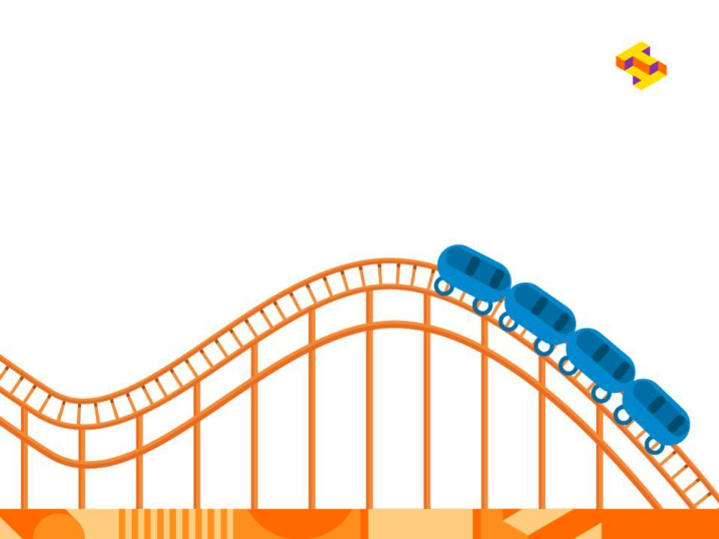
Challenge
You and your engineering partner are on opposite sides of the world, collaborating on the design and construction of Disneyland’s newest roller coaster!

Slide 2
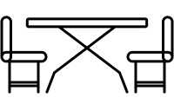


Constraints
Your device must be stable -
meaning it must stand on its own
Your roller coaster must have at
least one vertical loop
Your cart must go down the hill by
the force of gravity alone -
no pushing!

Slide 3
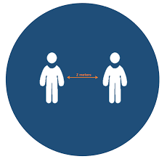
Constraints continued
Due to social distancing guidelines, only one engineer can be onsite at a time. You and your partner will need to take turns being physically present at the “work site” however you can still communicate from a distance.

Slide 4


Criteria
Criteria is an engineer’s measure for success. Here is how we will know when our roller coasters are successful:
Your roller coaster must be reliable,
meaning it must travel the entire length
of the coaster without falling out at least
3 times in a row.
Your cart must end in the provided cup at
the end of your track. This represents the
end of the ride!

Slide 5
Reflection
With your team, discuss the following:
What actions did you and your partner do during course of the activity? Write your keywords down on the yellow post-it notes
What actions did the facilitator do during the course of the activity? Write your keywords down on the blue post-it notes
Notes:
Collect post-it notes and categorize on the whiteboard

Slide 6
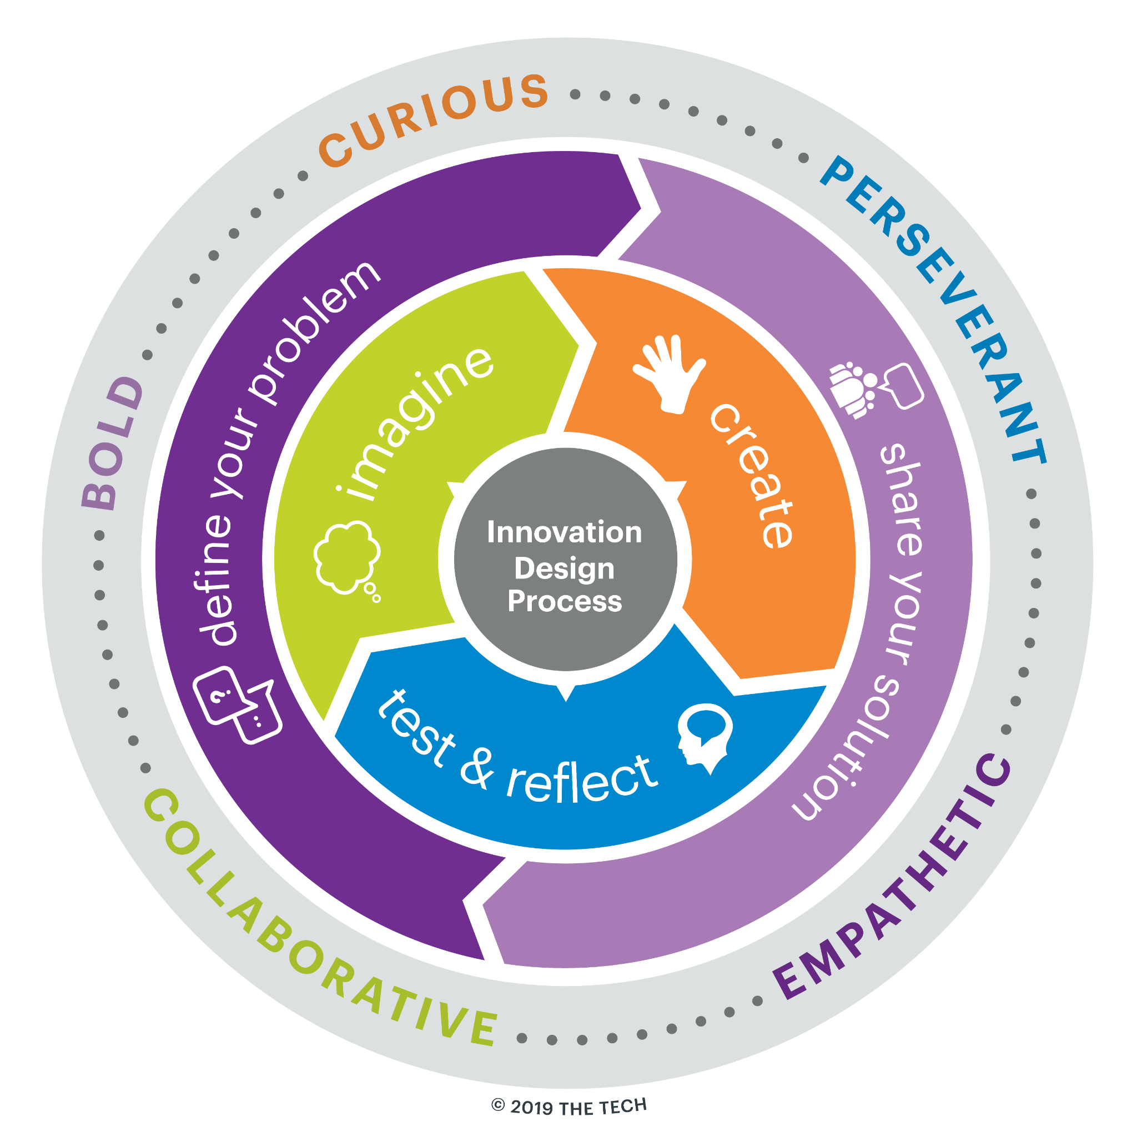
Innovation Design Process
Where do you think your yellow post-its fit on this graphic?
Where do you think your blue post-its fit on this graphic?
Notes:
Talk about the design process and how their actions fit in that process. Did their actions take place in a linear fashion? Were there certain parts of the process they were more focused on? Why?
Review mindsets - did they feel like they had any of these mindsets during the experience? When?
This is Design Challenge Learning - a dynamic way to develop learners as creative problem-solvers using real-world problems. Hands-on design challenges engage learners in an iterative and collaborative Innovation Design Process and build Innovator Mindsets that are key to future success.
How did the facilitator’s actions support you in the Innovation Design Process? Add your yellow post-its to the graphic where you think the actions supported that part of the process or encouraged you to use a particular mindset.

Slide 7

Role of the Educator
Support the learner through the Innovation Design Process.
Validate ideas and feelings
Ask open ended questions
Encourage
Make the experience relevant
Build Innovator Mindsets
Bold
Curious
Collaborative
Empathetic
Perseverant
This work is licensed under a CC BY 4.0 license.

