Slide 1
Strategies to use with Educators and Children

Slide 2
Talk Moves
Wait Time: Take time to observe what child does in response to a failure. Notice before responding. If they seem stick, use Stop and Jot or Think-Pair-Share.
Revoice: Restate what a child said by repeating, rephrasing, or translating their words.
Say more: Probe more into their thinking.
Acknowledge student struggle: Explicitly highlight students' efforts to persevere through a problem-solving situation so that students know that their effort is observed, appreciated, and considered productive.
I notice… (You notice…) I wonder… (You wonder…)
Notes:
From watching the videos, educators are quick to provide suggestions based on their observations and/or expertise.

Slide 3
Sentence Stems or Starters for Kids
A sentence stem is the beginning of a sentence. Think of the stem of a plant. It's not the whole plant, just the beginning of it. Sentence stems give students the inertia to get their thoughts going.
What surprise me was ______ because _______.
I don’t understand why _______.
I am having a difficult time with ________.
I found the problem to be ______.
I am going to change _________ because ________.

Slide 4
Sentence Stems or Starters for Educators
I did the same thing as _______ where _______.
I disagree/agree with _______ because ______.
I viewed ________ from an alternative perspective.
Adding on to what _______ said, I think ________.
I appreciate how you ___________.
Can you tell me more about why you did _______?
How is ______ similar to/different from ________?

Slide 5
Critiquing Circles (Thanks Thinkery!)
Way to inspire children “to want and to give feedback so they can grow and they can help others grow.”
Use an educator’s “poor” example or model for kids to critique and build upon. This can be done 2-3 times as the educator makes improvements of their draft based on children’s feedback.

Slide 6
How can I show a growth mindset through my words?
Give students a list of statements to identify which statements represent a fixed mindset or a growth mindset.
I can’t make this any better.
I can’t.
It’s too hard.
I’m not good at this.
I can do better.
Explain to students that part of having a growth mindset is expressing it in your words, which can in turn influence the way they think about things and their habits. As a group, re-write fixed mindset statements as growth mindset statements. Instead of saying, “I’m not good at this,” I might say “This is not my strength but I will ask for help.”
Notes:
From Mathematical Agency Improvement Community Network

Slide 7
Would you rather…?
Experience one epic failure. If so, place both hands on your head.
Experience 10 small failures. If so, place both hands over your eyes.
Notes:
Way to build a community. Help support those that are shy. Works well in an online format. A way to also probe how they define or see failure.

Slide 8
Would you rather…?
Do some research
Take a walking break
Ask a question
Make a change
Notes:
Also use as an approach to provide a strategy. Keep it broad.
Have a template on hand with a range of strategies to choose from

Slide 9
Developing Idea: Tour
Tour the space for learning with educators and engage in a conversation around:
Placement of testing station (e.g., public or private space)
Placement of an “unstuck” station
Placement of a frustration board
Placement of materials
Where to conduct demonstrations
Placement of instructions

Slide 10
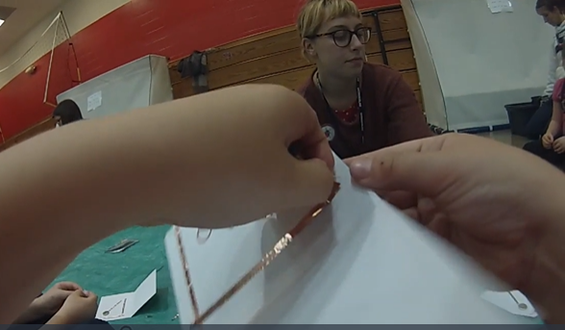
What do you notice? What do you wonder?
Self-Reflection: "What did you learn from this and/or how did you feel about teaching this time?
Appreciation: "What did you appreciate about _______'s teaching?" Or "What about _______'s teaching made you feel good as a student?"
Reflection/Surprises: "Was anyone surprised by anything that happened?" Or "What were your surprises?"
Closer Look: "Does anyone have any questions they would like to ask [the facilitator and/or the trainer]?"
Action Plan: "What do you want to work on?", followed by "How do you think you can do that?" Or you may simply ask, "What are you taking away from this experience?"
Notes:
VTS Coaching Questions
https://vtshome.org/facilitating-a-vts-coaching-session/
Our goals here are self-awareness and individual agency.

Slide 11
Reflect
Discuss how you might you modify and/or use 2-3 of the strategies within the PD cycle (e.g., workshops, reflections, pedagogical approaches, etc.).
What pedagogical strategies might we adapt or develop that would support educators to take pedagogical risks before and after youth experience failure? (What does it mean to take pedagogical risks?)
Notes:
Bakken & Amazeum
Thinkery & Montshire & Tech?

