Slide 1
Paper Hats!
Get out your materials!
You will need paper, scissors, tape

Slide 2
Paper Hats
Activity Instructions: You will make a paper hat.
3 breakout groups
No additional instructions
Instructions here
Inspiration photos here

Slide 3
Paper Hats Reflection
Reflection as a learner (2 min individual reflection, 5-8 min share out)
How did that feel as a learner? Did you feel like you failed at something?
Reflection as an educator (2 min individual reflection, 5-8 min share out)
How did the materials, instructions, etc lead to failure?
Notes:
Set up the feeling of failure
Failure “friendliness”
Learner: uncertainty, but very low stakes
Oh, ok, this is boring,
Facilitator: motivation,
Set up for different kinds of success
Freedom within well defined boundaries

Slide 4
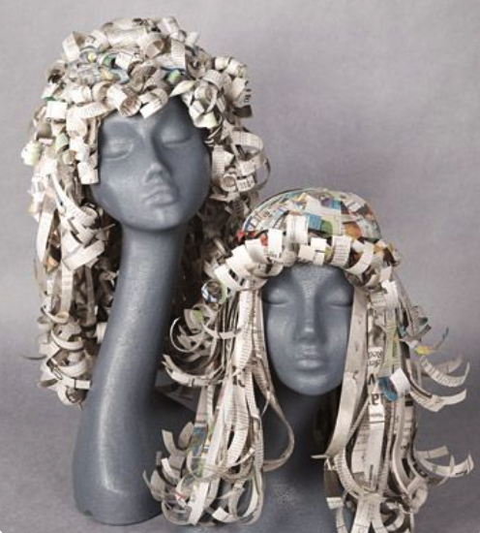
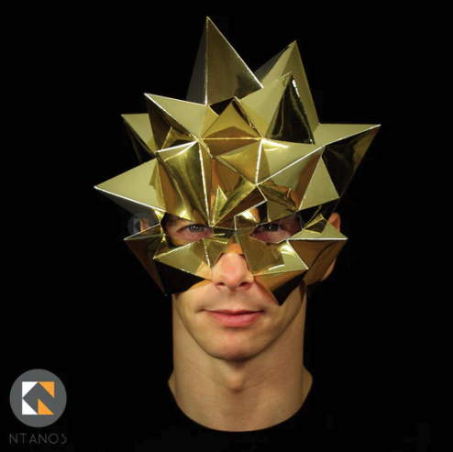
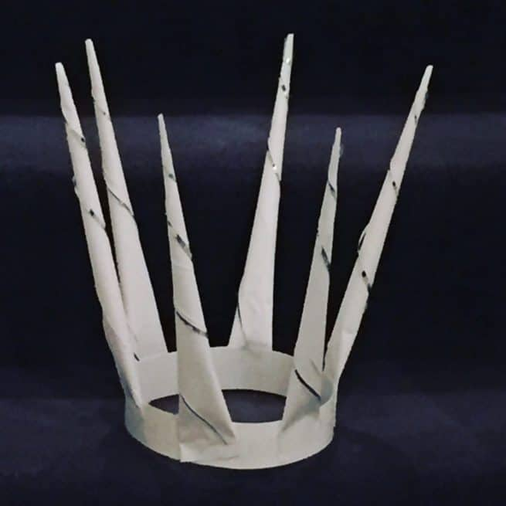
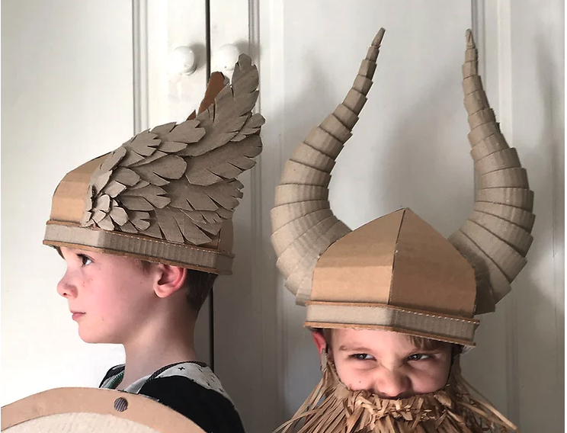
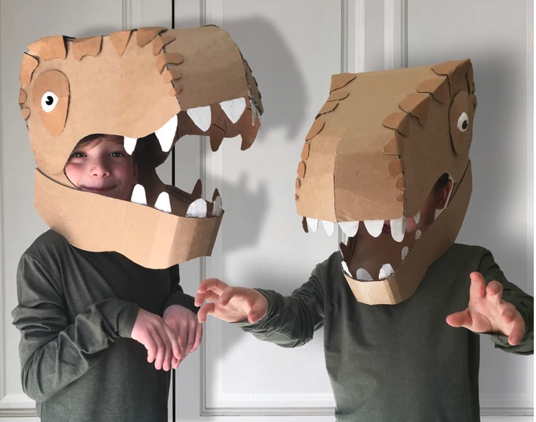
Notes:
Photo Sources:
https://www.behance.net/gallery/361396/TopshopIncuPaperform
https://feltmagnet.com/crafts/Mad-Hatter-of-Loveland-Colorado-Alice-in-Wonderland-Design-Top-Hat-Illustrated-step-by-step-Up-cycled-materials
https://www.marthastewart.com/265515/paper-wigs
https://ntanos.co.uk/collections/carnival-of-venice-masks/products/blast-mask-easy-low-poly-polygon-mask-pdf-download
https://www.zygotebrowndesigns.com/post/2016/08/27/cardboard-viking-helmet-with-horns
https://internationalelfservice.com/how-to-make-a-fairy-snow-queen-crown/

Slide 5
